Slide 1
Designing Clean Data Model Graphs
16 September 2011
Notes:
Creating New Entities - <number>
Guidewire training materials contain Guidewire proprietary information that is subject to confidentiality and non-disclosure agreements. You agree to use the information in this manual solely for the purpose of training to implement Guidewire software solutions. You also agree not to disclose the information in this manual to third parties or copy this manual without prior written consent from Guidewire. Guidewire training may be given only by Guidewire employees or certified Guidewire partners under the appropriate agreement with Guidewire.

Slide 2
Lesson objectives
By the end of this lesson, you should be able to:
  Describe how the claim graph defines the boundaries of information for a given claim
  Add a new entity to the claim graph
  Describe the common issues concerning overlap, other, and cross-claim entities
  Identify errors in a malformed data model graph
  This lesson uses the notes section for additional explanation and information.
  To view the notes in PowerPoint, choose View→Normal or View→Notes Page.
  If you choose to print the notes for the lesson, be sure to select “Print hidden slides.”
Notes:
Creating New Entities - <number>

Slide 3
Lesson outline
Overview of data model graphs
Claim graph entities
Admin data entities
Overlap entities
Other entities
Data model graph tools
Notes:
Creating New Entities - <number>

Slide 4

Claim information is spread across objects
For any given claim, the information about that claim is spread over of a number of objects, including:
  The claim object
  itself
  Objects uniquely
  "owned" by the
  claim
  Objects that are
  referenced by this
  claim as well as
  other claims
claim 127
exposure 31
vehicle
incident 8
activity 635
user 96
(owned by user 96)
Notes:
From a logic perspective, a claim "owns" an object if the object is referenced only by that claim (and the claim's sub-objects) and by no other claim (nor the sub-objects of any other claim).
From a technical perspective, a claim "owns" an object if the object has a foreign key field that references either the claim or one of its sub-objects.
Ownership cascades from the claim through all of its sub-objects. For example, if a claim owns an exposure and an exposure owns a reserve transaction, then the claim is also said to own the reserve transaction.

Slide 5
Who cares about "a claim and its objects"?
Several ClaimCenter features process a "claim and its objects" as a unit
  Archiving
    "The claim and its objects" are copied to the archive and then removed from the primary database
    Admin objects referenced by that and other claims (such as users and groups) are not archived
  Canceling out of the New Claim wizard / Purging
    "The claim and its objects" are deleted from the database
These features make use of a "data model graph”
  In ClaimCenter, this is known as the claim graph
All customers need to care because a clean claim graph is required to start the ClaimCenter server
Notes:
The data model graph feature exists to support two ClaimCenter features: archiving and purging.
Archiving is a feature that removes claims and their sub-objects from the ClaimCenter database and stores them in a file. The database stores claims that are "active" (such as open claims, recently closed claims, or claims recently restored from the archive). The archive stores "inactive" claims (closed claims for which there has been no recent activity). Regular archiving of inactive claims serves to reduce the size of the active database and improve efficiency. Searches within ClaimCenter return both active and archived claims.
Purging is a feature that permanently removes claims and their sub-objects from the database. Once purged, the claim cannot be searched for or restored. Claims can be purged for various reasons, including removal of claims mistakenly entered, and claims that have aged beyond the point of a carrier’s data retention policy. The purge is executed by the purge batch process. This batch process physically deletes all claims (and their sub-objects) that have been marked as retired. There are two ways a claim can be marked as retired:
Cancelling out of the New Claim Wizard
Administrators can retirie a claim manually via the maintenance_tools command line (or the corresponding SOAP API)
There is no way for a user in ClaimCenter to manually retire a claim.

Slide 6
The claim graph
The claim graph consists of the Claim entity and all other entities whose instances can be owned by a single claim
Claim
Exposure
Policy
Incident
Coverage
Notes:
Ownership can be direct or indirect. For example, every exposure, incident, and policy is directly owned by a single claim. (When a policy is brought over to ClaimCenter, it is brought over as a snapshot. Every claim has its own copy of the policy. So even if two or more claims are based on the same logical policy, each claim has its own snapshot and therefore uniquely owns that copy of the policy.) Every coverage is also owned by a single claim, but the ownership is indirect. Coverage does not have a foreign key to Claim, but rather to Policy, which in turn has a foreign key to Claim.
The claim graph consists of a single hierarchy with a single root entity (Claim). It must be complete enough such that when a claim is removed or moved to the archive, everything uniquely related to the claim gets moved with it. (All entities in the claim graph are connected directly or indirectly to Claim, and therefore directly or indirectly to one another.)

Slide 7
Claim graph instances
A claim graph instance is a set of objects consisting of one claim and all the objects uniquely owned by that claim
  It does not include "admin" data referenced by multiple claims
Claim graph instance for claim 127
claim 127
exposure 31
vehicle
incident 8
activity 635
user 96
(User 96 is referenced by many claims and therefore is not uniquely owned by claim 127)

Slide 8
Admin data
Admin data consists of the entities whose instances can be referenced by multiple claim graph instances
Admin data
User
Group
ActivityPattern
Notes:
Unlike the claim graph, admin data does not necessarily have a single root entity or consist of a single hierarchy. It typically contains multiple tables connected to one another (such as User and Group), but it also contains other data completely disconnected from the rest. For example, aside from the CreateUser and UpdateUser fields, there is no connection between User and ActivityPattern.

Slide 9
Every entity is one of four possible types
Claim Graph
Exposure
claim graph
entity
Admin data
Address
overlap
entity
BusinessWeek
User
other entity
admin data
entity
Notes:
A "claim graph entity" is an entity that belongs only to the claim graph. Each of its instances belong to a single claim. One example is the Exposure entity.
An "admin entity" is an entity that may be referenced by multiple claims but is not owned by any of them (even though a given instance may be referenced by zero or only one claim). One example is the User entity.
An "overlap entity" is an entity that belongs to both the claim graph and admin data. This occurs when some instances of the entity are owned by a single claim and other instances are referenced by multiple claims. An example of this is Address. In some cases, an address is associated to a single claim, such as the address for a claim's loss location. In other cases, an address is referenced by multiple claims, such as the address for a given user that could be the owner of multiple claims. For an overlap entity, every instance is either a "single claim instance" tied to a claim graph entity or a "multi-claim instance" tied to an admin entity. There are only a small number of overlap entities and almost all of them are related to the Contact entity.
A “other" entity is an entity that belongs to neither the claim graph nor admin data. There are two basic types of other entities. The first is "system data" entities, which include data needed for basic application functionality that doesn't have any relationship to claims processing. One example is the BusinessWeek entity, which is used to define business weeks. (For example, for a given week, is Monday a business day for that week?) The second is "cross-claim" entities, which link multiple claims together. One example is ClaimAssociation, which identifies two or more claims as being related to one another.

Slide 10
Technical differences between each type
Claim Graph
Claim graph instances are:
  Copied to archive and removed from database during archiving
  Removed from database during purging
Admin data and Other instances are not removed from database as a result of archiving or purging
Overlap instances are treated as either claim graph or admin data instances, depending on the individual instance
Exposure
claim graph
entity
Address
overlap
entity
BusinessWeek
User
other
entity
Admin data
entity
Admin data
Notes:
An overlap entity is an entity that has claim graph instances and admin data instances. So, for an overlap entity, some of its instances are copied to the archive and then removed from the database, and some of its instances are left in the database.

Slide 11
Adding new entities to ClaimCenter
When you create a new entity in ClaimCenter, you must decide whether it belongs to the claim graph and configure it appropriately
  If an entity should be part of the claim graph but isn't, its instances will not be removed (archived or purged) when the claim is removed
  If an entity is added to the claim graph incorrectly:
    ClaimCenter may not start
    The databases could be put into an inconsistent state
Notes:
The ClaimCenter server performs a series of checks during startup. These checks verify that the current data model has a well-formed claim graph that can support archiving and purging of claims. In some cases, a failed check will prevent the server from starting. (Other checks, when they fail, will allow the server to start but will log warnings. These warning identify potential problems with the graph that might not be an issue depending on business logic.)
ClaimCenter cannot always detect misconfigured entities at startup. If you misconfigure an entity and ClaimCenter does not detect this at start up, then the archive process can put the database in an inconsistent state. For example, if you've configured an entity so that it is in the claim graph when it's actually shared admin data, then archiving will probably fail at runtime, though possibly after appearing to successfully archive some claims. This leaves the databases in an inconsistent state. If you've configured an entity so that it is shared admin data when it's really uniquely owned by each claim, then it will be stranded in the database when the claim is archived.

Slide 12
Lesson outline
Overview of data model graphs
Claim graph entities
Admin data entities
Overlap entities
Other entities
Data model graph tools
Notes:
Creating New Entities - <number>

Slide 13
Relationship terminology
References
(A) Incident
(B) Claim
<foreignkey>
Owns
If entity A has a foreign key to entity B, then:
  Entity A "references" entity B
  Entity B "owns" entity A
Typical foreign key relationship is “owned by” in the direction of the foreign key
  Possible to define foreign keys as “own” relationship by setting owner=“true” parameter in foreign key definition
Notes:
In the example above:
Incident has normal “owned by” foreign key to Claim
Incident references Claim
Claim owns Incident
In this lesson, solid-line arrows are used to represent "reference“ or “owned by” relationships unless otherwise noted. When a foreign key is involved, these lines point from the entity with the foreign key to the entity the foreign key references.

Slide 14
Claim graph entities
A new entity should be added to the claim graph if every instance uniquely belongs to only one claim
Claim
Incident
VehicleBodyDamage
(custom entity)
dent
Notes:
In the example above, a new VehicleBodyDamage entity is being added to ClaimCenter. Every instance of VehicleBodyDamage is a dent or scratch that references only one VehicleIncident, and therefore belongs uniquely to only one claim. Because of this, VehicleBodyDamage should be added to the claim graph. (VehicleIncident is a subtype of Incident.)

Slide 15
Creating claim graph entities
claim graph
Extr
To configure an entity as a claim graph entity, the entity must both:
  Implement the Extractable delegate
  Have a foreign key to an existing claim graph entity
<fk>
(new)
Admin data
Notes:
From a technical perspective, ClaimCenter considers an entity to be part of the claim graph if it has a foreign key pointing to a claim graph entity.
If you create a new entity that has a foreign key pointing to a claim graph entity but does not implement the Extractable delegate, ClaimCenter will not start. It assumes the entity is part of the claim graph and the error message states you must implement the Extractable delegate.
If you create a new entity that does not have a foreign key pointing to a claim graph entity but does implement the Extractable delegate, ClaimCenter will not start. It assumes the entity is not part of the claim graph and the error message states you must remove the line that implements the Extractable delegate.

Slide 16
The Extractable delegate
Extractable
VehicleBodyDamage
The Extractable delegate contains methods needed to cleanly remove (archive or purge) an object from the primary database
  Every entity that belongs to the claim graph must implement this delegate
  Entities that do not belong to the claim graph must not implement this delegate
Notes:
A delegate is a virtual entity consisting of database fields and/or methods that can be reused by multiple concrete entities. Delegates bundle together functionality that is needed by multiple unrelated entities.
The archiving process interacts with all entities that implement the Extractable delegate. Therefore, an entity whose instances are not to be archived cannot implement the Extractable delegate.
If an entity that is not part of the claim graph implements the Extractable delegate, ClaimCenter throws an error during start-up and does not start. The error message says "The following are not in the Domain graph but implement Extractable (remove <implementsEntity name="Extractable"/>) : EntityName.“

Slide 17
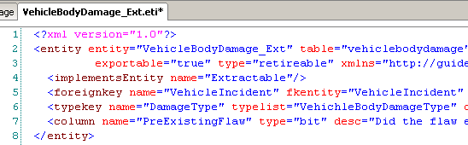
1. Implementing the Extractable delegate
Syntax:
  <implementsEntity name="Extractable"/>
Notes:
To implement the delegate, include the line <implementsEntity name="Extractable"/> in the entity definition (or extension) file.

Slide 18
2. Creating a valid relationship
The new entity must also have at least one foreign key pointing to an entity in the claim graph
  The new entity is owned by the existing entity
Owner entity may have:
  No reference to new entity
  An array of the new entity
  A one-to-one or edge
  foreign key to the new
  entity
<foreignkey>
Owner
Entity
New
Entity
<foreignkey>
Owner
Entity
New
Entity
<array>
<foreignkey>
Owner
Entity
New
Entity
1
<onetoone>
Notes:
There is no restriction on the number of foreign keys a new entity can have that point to claim graph entities. To be in the claim graph, a new entity must point to at least one entity (such as Exposure). But it is acceptable to have multiple foreign keys to multiple claim graph entities (such as one to Exposure and another to Claim). Note that it is the developer’s responsibility to ensure that all the foreign keys point to entities belonging to the same claim.

Slide 19
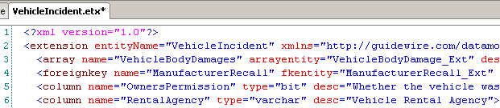
Foreign key example
<foreignkey>
Owner
Entity
New
Entity
<array>
Notes:
In the example above, the VehicleBodyDamage_Ext entity must be added to the claim graph. Therefore, in addition to implementing the Extractable delegate, it also has a foreign key to an entity that is already in the claim graph (VehicleIncident, which is a subtype of Incident). The VehicleIncident entity also has an array of VehicleBodyDamage that points to the VehicleBodyDamage_Ext entity.

Slide 20
Lesson outline
Overview of data model graphs
Claim graph entities
Admin data entities
Overlap entities
Other entities
Data model graph tools
Notes:
Creating New Entities - <number>

Slide 21
Admin data entities
An entity is considered part of Admin data if:
  Its instances can be referenced by multiple claim graph instances,
  OR
  There is a foreign key relationship from an existing Admin data entity to the new entity
Manufacturer
Recall_Ext
Catastrophe
ReliefFund_Ext
<foreignkey>
Notes:
A new entity should be part of the Admin data if either of the following are true:
An entity in the claim graph has a foreign key to the new entity, but the new entity is not part of the claim graph. (This occurs when multiple claim graph instances must reference a single instance of the new entity. Because multiple claim graph instances reference a single instance of the new entity, the new entity cannot be added to the claim graph.)
An entity in the Admin data has a foreign key to the new entity.
There is a third circumstance in which an entity must be in the Admin data. This third circumstance involves an entity that has a foreign key to an Admin data entity and stores either data needed for the login process (such as User and Organization) or data needed while the server is in archive mode. It is highly unlikely that a customer will ever need to create this type of Admin data entity. Therefore, the remainder of this lesson ignores this case. If you suspect you do need to add a new entity of this type, consult with your Guidewire resource.

Slide 22
Creating Admin data entities
claim graph
Nothing special needs to be done to “declare” an entity to be admin data
<fk>
(new)
<fk>
(new)
Admin data
Notes:
ClaimCenter always considers a new entity to be part of the Admin data if there is a foreign key from a claim graph entity or from an Admin data entity to the new entity.

Slide 23
Lesson outline
Overview of data model graphs
Claim graph entities
Admin data entities
Overlap entities
Other entities
Data model graph tools
Notes:
Creating New Entities - <number>

Slide 24
Overlap entities
Overlap = some instances associated with one claim, and some associated with many
Claim Graph
Claim
Contact
claimant
claim owner
(CC user)
witness
Admin data
Notes:
Overlap entities are entities for which some instances need to be owned by a particular claim, and some instances do not. Those that do not may be referenced by multiple claims or only by other non-graph instances.
For example, Contact is an overlap entity. This is because Contact stores contact information for two kinds of contacts:
Contacts that are involved in a claim (claimants, witnesses, and so on) – these should be in the claim graph
Contacts that are working on the claim (users) – these should not be in the claim graph
In the example above, the first contact is a claimant that is referenced by only the first claim graph instance. Similarly, the third contact is a witness that is referenced only by the third claim graph instance. However, the second contact is a claim owner (a ClaimCenter user.) It is referenced by all three claim graph instances.

Slide 25
Overlap entities
Overlap entities typically store contact and address information
  This is because ClaimCenter uses a single set of entities for both claim-specific contacts and carrier-related contacts
Customers typically need to add few or no overlap entities
  Mostly contact-related entities
  If you feel your implementation needs an overlap entity, consult with a Guidewire resource for more information
Notes:
The following entities are most of the overlap entities in the ClaimCenter base application: Address, AddressCorrection, Contact, ContactAddress, ContactCategoryScore, ContactContact, EFTData, OfficialID.
Creating a new overlap entity is beyond the scope of this course. If you believe your implementation needs a new overlap entity, consult with a Guidewire resource for assistance in designing the entity.

Slide 26

Identifying overlap entities
Overlap entities must implement two delegates:
  Extractable
  OverlapTable
Notes:
The following entities are the only overlap entities in the ClaimCenter base application: Address, AddressCorrection, Contact, ContactAddress, ContactCategoryScore, ContactContact, EFTData, OfficialID.

Slide 27
Lesson outline
Overview of data model graphs
Claim graph entities
Admin data entities
Overlap entities
Other entities
Data model graph tools
Notes:
Creating New Entities - <number>

Slide 28
Other entities
Other entities do not belong to either the claim or Admin data
There are two types of other entities:
  "System data" entities
  "Cross-claim" entities

Slide 29
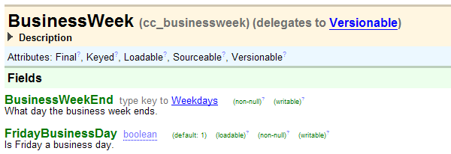
"System data" entities
A "system data" entity is a other entity that does not store information specific to any one claim or any group of claims
  This includes lookup tables (storing, for example, tax rates), calendar data, and so on
Notes:
The primary issue is whether the entity in question is referred to by foreign keys from within the claim graph. If an entity has no foreign keys from any claim graph or Admin data entities, then it could potentially be system data.

Slide 30
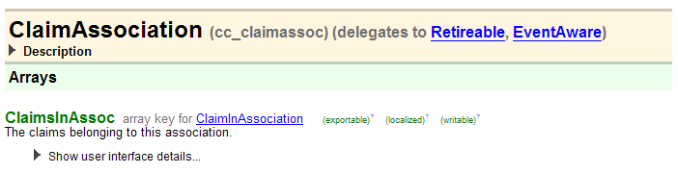
"Cross-claim" entities
A "cross-claim" entity is an entity that links together two or more claims
  Unlike an admin entity, an instance of a cross-claim entity cannot be created (in a meaningful way) if there are no claims in the system
Notes:
A ClaimAssociation represents a typed grouping of a set of claims. The relationship between Claim and ClaimAssociation is N-M. In other words, each claim may be referenced by multiple claim associations, and each claim association references multiple claims. In addition, the same two claims may be joined by multiple associations. The type of each association is one of the values in the ClaimAssocType typelist. In a claim purge, an association will only be purged if it has no remaining claims in it.
BulkInvoice is another example of a cross-claim entity. BulkInvoice is the top level entity for Bulk Pay, which corresponds to the incoming invoice or bill to be paid. It has a unique ID (which may correspond to the invoice), some data fields (such as payee and a scheduled send date), and a non-null array of bulk invoice items (refer to the BulkInvoiceItem entity for details). A bulk invoice is not associated with a single claim, but each line item (each BulkInvoiceItem) is associated with a different claim.

Slide 31
Creating other entities
claim graph
To configure an entity as a other entity:
  Either:
    Create a foreign key to an Admin data entity, or
    Create no foreign keys to or from entities from either graph
<fk>
(new)
(new)

Slide 32
Modeling cross-claim entities
Claim
MultiCar
Accident_Ext
Cross-claim entities can be problematic to model, because they store claim-centric data owned by more than one claim
  It is difficult to archive claim A and not archive claim B when claims A and B own the same cross-claim instance
Notes:
When a claim is archived, the claim and all of its sub-objects are copied to the archive and then removed from the primary database. If two claims own the same cross-claim entity, then there is a problem when one claim is archived and the other isn't.
If you archive the cross-claim instance, then foreign keys on the second claim will break because they reference the now non-existent cross-claim instance.

Slide 33
The ClaimInfo object
<onetoone>
1
Claim
Info
Claim
<foreignkey>
The ClaimInfo entity has a one-to-one relationship with Claim
  Each instance stores summary information about one claim
The ClaimInfo entity has special behaviors which exclude it from the Claim graph
  When a claim is archived, its ClaimInfo object remains in the primary database
  This allows for searches across active and archived claims
Notes:
ClaimInfo has a one-to-one relationship with Claim. The purpose of the ClaimInfo entity is to maintain summary information about a claim for the point in time when the claim is archived. During archiving, the Claim instance is copied to the archive and then removed from the primary database. However, the ClaimInfo instance remains. Claim searches are conducted against the ClaimInfo entity, which lets searches return results from both "active" and archived claims.
The ClaimInfo object is created when the corresponding claim is created.

Slide 34
Implementing cross-claim entities
MultiCar
Accident_Ext
Claim
<onetoone>
<foreignkey>
1
Claim
Info
MultiCar
Accident_Ext
Claim
<foreignkey>
You can implement a cross-claim entity by relating the entity to ClaimInfo
  ClaimInfo is not part of the claim graph, and therefore is not removed when a claim is removed
  This avoids the problem of having a cross-claim instance refer to a claim which is present and a claim which has been removed
Notes:
To solve the problem, cross-claim entities should reference the ClaimInfo entity. Although each instance is owned by a single claim, the entity has special behaviors that exclude it from the claim graph. If a single entity references multiple ClaimInfo instances, there are no problems if some of the corresponding claims have been removed from the database while others are still in the database.
There may be some circumstances where a new entity needs to reference multiple sub-objects across multiple-claims (such as multiple checks or multiple documents). If you need to model this type of an entity, consult with a Guidewire resource on your implementation project.
ClaimCenter has special internal handling for the ClaimInfo entity so that it can have a foreign key to Claim and yet not be extractable. This functionality is not available for customer entities. (In other words, you cannot create a custom "Info" entity.)

Slide 35
Review: Cross-claim vs. admin entities
A new entity is considered an
admin entity if its instances:
  Store values that are referenced by multiple claims, but...
  Can exist even if there are no claims
A new entity should be a
cross-claim entity if its instances:
  Are used to link two or more related claims together, and...
  Cannot exist in a meaningful way if there are no claims
You should not model cross-claim entities as admin entities
User
Group
BulkInvoice
ClaimAssociation
archive
Notes:
The question of whether a given entity should be admin or cross-claim does not always have a clear answer. If you have questions about the appropriate way to model a given entity that is related to multiple claims, consult with a Guidewire resource.

Slide 36
Review of graph ownership
Claim graph
Extr
<fk>
(new)
<fk>
(new)
<fk>
(new)
<fk>
(new)
(new)
Admin data
Notes:
Claim graph entities
If a new entity has a foreign key to a claim graph entity, then the new entity is owned by the existing claim graph entity. The new entity becomes part of the claim graph and must implement the Extractable delegate. (Base app example: Exposure)
Admin data entities
If a claim graph entity has a foreign key to a new entity, then the new entity is referenced by the existing claim graph entity. The new entity is considered part of the Admin data. (Base app example: User)
If an Admin data entity has a foreign key to a new entity, then the new entity is referenced by the existing Admin data entity. The new entity is considered part of the Admin data. (Base app example: Credential)
Overlap entities
If you need to configure a new overlap entity, consult with a Guidewire resource.
Other entities
If a new entity has a foreign key to an Admin data entity, then the new entity is not added to either graph. (Base app example: DashboardStats)
If a new entity has no foreign keys to or from any entities in the claim graph or admin data, then it is a other entity. (Base app examples: BusinessWeek (system data) and ClaimAssociation (cross-claim))

Slide 37
Lesson outline
Overview of data model graphs
Claim graph entities
Admin data entities
Overlap entities
Other entities
Data model graph tools
Notes:
Creating New Entities - <number>

Slide 38
Data model graph tools
ClaimCenter provides tools to prevent and correct data models with claim graph problems
  Data model checks during start-up
  DOT format descriptions of data model
Notes:
If a data model did not have clearly defined boundaries for the claim graph, then when a claim is removed, restored, or retired:
Sub-objects belonging to the claim would not be correctly removed, restored, or retired.
Sub-objects belonging to other claims (and/or other claims themselves) might inadvertently also be removed, restored, or retired.

Slide 39
Data model checks during start-up
During start-up, ClaimCenter verifies the data model meets the following requirements (and will not start if any are not met):
  All entities in claim graph implement Extractable delegate
  No entities outside claim graph implement Extractable delegate
Notes:
The ClaimCenter server performs a series of checks during startup. These checks verify that the current data model can support archiving, purging and export of claims. Some of these checks prevent the server from starting. Other checks are warnings and allow the server to start. These checks warn about potential problems with the graphs that might not be an issue depending on business logic.
The following checks are also performed during startup:
Overlap tables implement OverlapTable - The overlap entities must implement the OverlapTable delegate.
Exceptions to links from outside the domain graph are outside the domain graph - ClaimCenter has some built-in exceptions to the general rule of not having a foreign key from an entity outside the domain graph to one inside the domain graph. For these entities, ClaimCenter verifies that the outside entity is indeed outside the domain graph.
For more information on data model checks during start-up, refer to the ClaimCenter Configuration Guide.

Slide 40
Errors during data model check
If a claim graph check fails, ClaimCenter:
  Reports only the first failed requirement it encounters
    If the requirement is an issue for multiple entities, then it reports on all entities which did not meet that requirement
  Prints information to the console and the log
  Identifies the entity (or entities) and the problem
  Provides a "DOT format description" of the data model

Slide 41
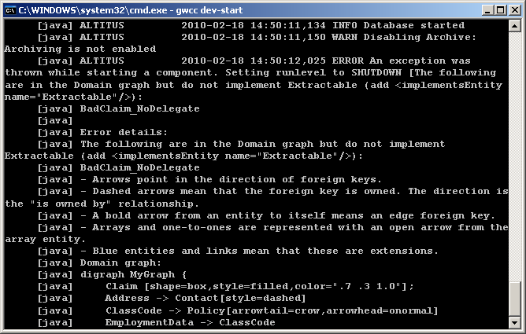
Sample error output in console
error
DOT
format
of
data
model

Slide 42
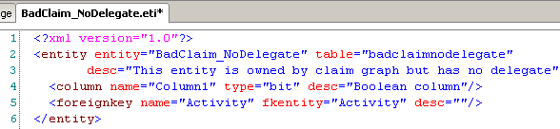
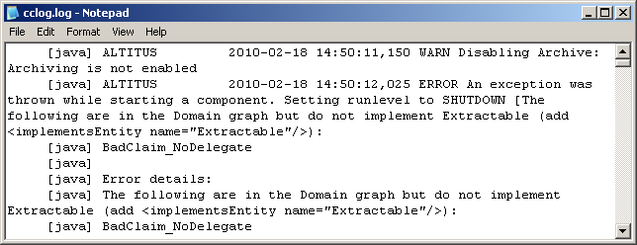
Data model flaw: Example 1
Claim graph entity with no delegate
Notes:
In the example above, the new entity, BadClaim_NoDelegate, has a foreign key to the Activity entity (a claim graph entity). This means the new entity is part of the claim graph. However, the entity doesn't implement the Extractable delegate. An excerpt from the cclog shows the error message.

Slide 43
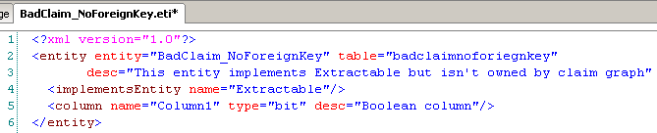
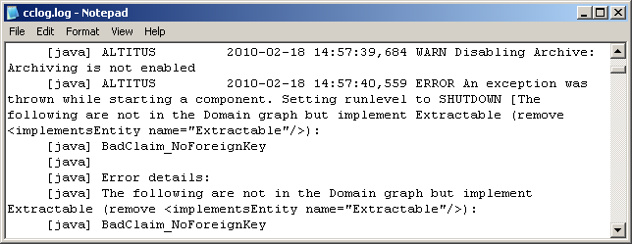
Data model flaw: Example 2
Claim graph entity with no foreign key
Notes:
In the example above, the new entity, BadClaim_NoForeignKey, has no foreign keys to any claim graph entities. This means the new entity is not part of the claim graph. However, the entity implements the Extractable delegate. An excerpt from the cclog shows the error message. (In this case, the suggestion in the error message may not be appropriate. The entity may be intended for the claim graph, in which case a foreign key to a claim graph entity must be added to fix the problem.)

Slide 44
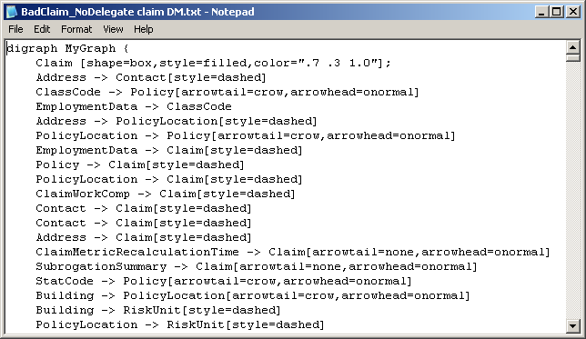
DOT format
DOT is a plain text graph description language
  Generated by ClaimCenter to describe data model from a graph perspective
  Can be
  converted
  into an
  image by a
  DOT viewer
  tool, such
  as Graphviz
Notes:
The DOT format described above should not be confused with Gosu's "dot notation", which is used to specify a field for a given object (such as aClaim.ValidationLevel).
To view a domain or admin data visually, you need to download and install additional software that can read .dot files and render an image from the DOT language. There are many viewers available (some open source or free) that you can use for this purpose. One such is Graphviz, which you can download from the following URL: http://www.graphviz.org/About.php

Slide 45
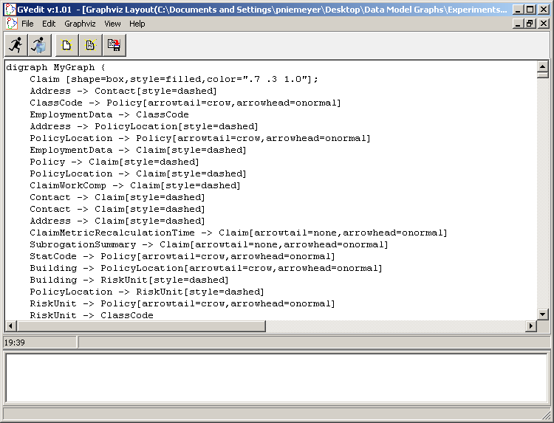
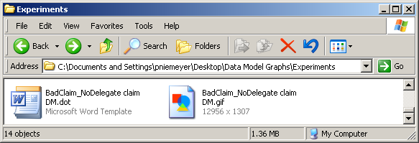
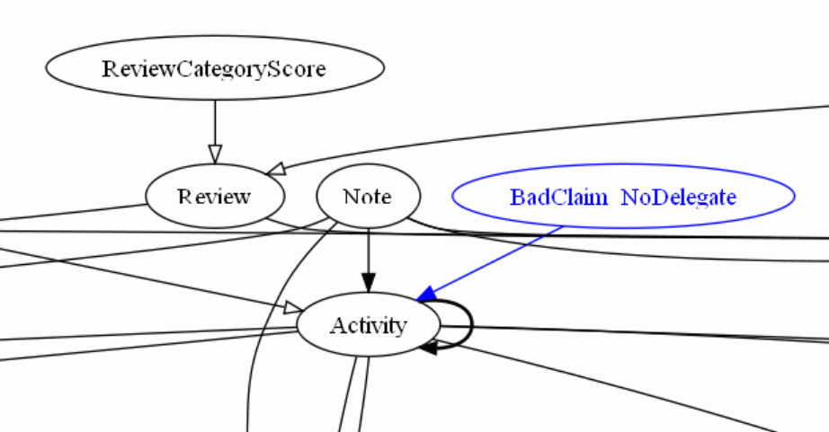
Sample DOT graph
Notes:
The DOT graph shown above was rendered using GVedit (version 1.01), which is a Graphviz tool that was downloaded from the following URL: http://www.graphviz.org/About.php
At a high level, the DOT graph notation was loaded into the tool. The tool then generated a GIF file. Finally, the GIF file was opened using Microsoft Paint. A snippet of the image is shown in the lower right corner. (The full image is significantly large as it visually depicts all entities in the given graph and their relationships.)
Within the graph, each notation has the following meaning:
Arrows point in the direction of foreign keys. The direction of the arrow is the is owned by relationship. (For example, Note is owned by Activity.)
A bold arrow from an entity to itself means an edge foreign key. (For example, Activity has an edge foreign key to itself.)
An open arrow from one entity to another entity represents either an array (multi-pronged tail) or a one-to-one relationship (single line tail). (For example, Review has an array of ReviewCategoryScores.)
Blue entities and links mean that these entities and links were defined through data model extensions. (For example, BadClaim_NoDelegate is a data model extension.)
A full discussion of DOT graphs and how to use them to diagnose data model problems is beyond the scope of this lesson. Consult the ClaimCenter Configuration Guide for further details.

Slide 46
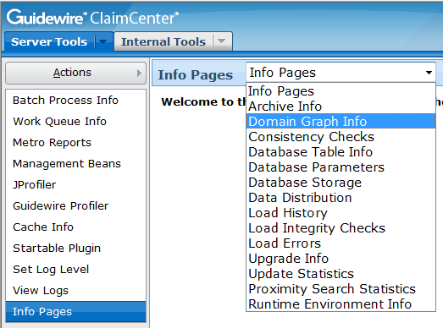
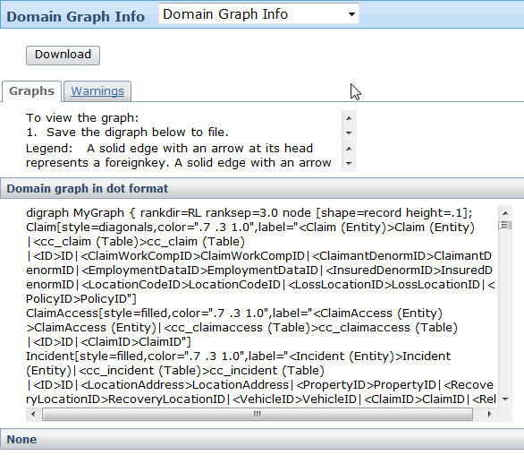
The Archive Graph Info page
Provides DOT formats for graphs (after successful server start-up)
Provides list of warnings
Notes:
The Archive Graph Info page provides information about both the claim graph (labeled above as the domain graph) and the Admin data. This information is relevant for clean data model design, whether a customer is implementing archiving or not.
The warnings tab warns of situations which could potentially lead to errors. ClaimCenter provides only warnings for these situations (rather than preventing the server from starting) because business logic may prevent the erroneous situation from becoming problematic. For a full list of warnings, consult the ClaimCenter Configuration Guide.

Slide 47
Lesson objectives review
You should now be able to:
  Describe how the claim graph defines the boundaries of information for a given claim
  Add a new entity to the claim graph
  Describe the common issues concerning overlap, other, and cross-claim entities
  Identify errors in a malformed data model graph
  This lesson uses the notes section for additional explanation and information.
  To view the notes in PowerPoint, choose View→Normal or View→Notes Page.
  If you choose to print the notes for the lesson, be sure to select “Print hidden slides.”
Notes:
Creating New Entities - <number>

Slide 48
Review questions
Replace each "__" with "only one claim" or "many claims":
  A claim graph instance contains a set of objects that have information about ______.
  Each instance of a claim graph entity (such as a document) references _____.
  Each instance of an Admin data entity (such as a user) is referenced by _____.
What kind of foreign key adds an entity to the claim graph? To the Admin data?
What line of XML can be found in an eti file that defines a claim graph entity?
How can you tell when your data has a malformed claim or Admin data?
Notes:
Creating New Entities - <number>
Answers
1. a) only one claim
b) only one claim
c) many claims
2. A foreign key to a claim graph entity adds an entity to the claim graph.
A foreign key from a claim graph entity or from an Admin data entity adds an entity to the claim graph.
<implementsEntity name="Extractable"/>
ClaimCenter does not start.

Slide 49
Notices
Copyright © 2001-2011 Guidewire Software, Inc. All Rights Reserved.
Guidewire, Guidewire Software, Guidewire ClaimCenter, Guidewire PolicyCenter, Guidewire BillingCenter, Guidewire Reinsurance Management, Guidewire ContactManager, Guidewire Vendor Data Management, Guidewire Client Data Management, Guidewire InsuranceSuite, Guidewire ContactCenter, Guidewire Studio, Gosu, Deliver Insurance Your Way, and the Guidewire logo are trademarks or registered trademarks of Guidewire Software, Inc. in the United States and/or other countries.
This material is Guidewire proprietary and confidential. The contents of this material, including product architecture details and APIs, are considered confidential and are fully protected by customer licensing confidentiality agreements and signed Non-Disclosure Agreements (NDAs).
This file and the contents herein are the property of Guidewire Software, Inc. Use of this course material is restricted to students officially registered in this specific Guidewire-instructed course, or for other use expressly authorized by Guidewire. Replication or distribution of this course material in electronic, paper, or other format is prohibited without express permission from Guidewire.
    Guidewire products are protected by one or more of the following patents: U.S. Patent No. 7,885,831; U.S. Patent No. 7,788,296.
Notes:
Introduction to Guidewire Configuration - <number>

